Slide 1
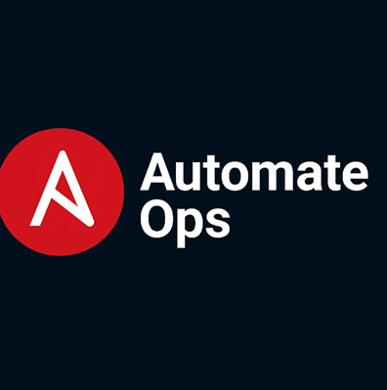

Ansible Vault Workflow
Securing automation through encrypted configuration management
Notes:
---

Slide 2
Learning Outcomes
🧩 Understanding Ansible Vault
🔒 What Vault is & why it exists
🧠 Security principles: AES‑256, protected Git workflow
⚙️ How Vault Works
⚡ Runtime decryption (in RAM)
🗃️ No plaintext written anywhere
📁 Encrypting Secrets Correctly
🧷 Variable‑level encryption (encrypt_string)
📄 File‑level encryption (ansible-vault encrypt)
🛠️ Core Commands Mastery
🆕 create
✏️ edit
👁 view
🔐 encrypt / encrypt_string
♻️ rekey
📂 Inventory Organization
🗂️ group_vars
🖥️ host_vars
🎯 least privilege secret placement
🧪 Hands‑On Demo Outcomes
✨ Encrypt a variable (db_password)
📘 Create & edit an encrypted file
▶️ Run a playbook using --ask-vault-pass

Slide 3
Agenda
What & Why: Ansible Vault in a nutshell
How it works: runtime decryption & inventory integration
Encrypting variables vs files
Hands‑on commands (cheat sheet)
Inventory structure (group_vars/host_vars) diagram
End‑to‑end workflow (Encrypt → Git → CI/CD → Runtime)
Vault IDs & multi‑environment model
Providing passwords securely
Best practices, pitfalls, and next steps

Slide 4
What is Ansible Vault?
Built‑in feature to encrypt variables and files (AES‑256)
Safe to commit to Git; decrypted only when needed at runtime
Works seamlessly with playbooks, roles, and inventory
Supports multiple vault passwords via Vault IDs

Slide 5
How Vault Works (Diagram)
Plain YAML vars (plaintext)
ansible-vault (encrypt)
Encrypted YAML (!vault block)
Git / Repo
ansible‑playbook (runtime)
Decrypted in RAM (no disk write)
AutomateOps

Slide 6
Encrypting Variables vs Files
Variables: Use `encrypt_string` to embed `!vault` blocks alongside plaintext vars
Files: Use `ansible-vault encrypt` for entire YAML/JSON files (vars, tasks, templates)
Rotation: File‑level encryption supports `rekey`; variable‑level blocks must be regenerated
Decryption: Variables decrypted on demand; files decrypted when loaded
AutomateOps

Slide 7
Vault Commands – Cheat Sheet
ansible-vault create secrets.yml ansible-vault edit secrets.yml ansible-vault view secrets.yml ansible-vault encrypt_string 'S3cret!' --name db_password ansible-vault encrypt credentials.yml ansible-vault rekey secrets.yml ansible-playbook site.yml --ask-vault-pass ansible-playbook site.yml --vault-id dev@prompt --vault-id prod@~/.vault-pass-prod

Slide 8
Inventory Structure (Diagram)
inventory/ ├─ group_vars/ │ ├─ all.yml (common, can hold vaulted vars) │ └─ web.yml (group‑scoped) ├─ host_vars/ │ └─ db1.yml (host‑specific) └─ hosts (inventory)
Place encrypted blocks in the correct scope for least privilege
`group_vars/all.yml` for all hosts; group/host files for narrow scope
Ansible auto‑detects `!vault` and prompts/uses vault‑id at runtime
AutomateOps

Slide 9
Encrypt → Commit → CI/CD → Runtime Decrypt
Encrypt (encrypt|encrypt_string)
Commit to Git (share safely)
CI/CD executes (ansible-playbook)
Vault password(s) (dev/prod via vault‑id)
Decryption in RAM (no plaintext on disk)

Slide 10
Vault IDs for Multi‑Environment
dev ———
vault-id: dev@prompt or dev@~/.vault-pass-dev
scoped secrets in group_vars/dev/
limited team access
qa ———
vault-id: qa@prompt or qa@~/.vault-pass-qa
scoped secrets in group_vars/qa/
limited team access
prod ———
vault-id: prod@prompt or prod@~/.vault-pass-prod
scoped secrets in group_vars/prod/
limited team access
AutomateOps

Slide 11
Providing Vault Passwords Securely
Interactive: `--ask-vault-pass`
File: `--vault-password-file ~/.vault-pass` (permissions 600; avoid committing)
Vault IDs: `--vault-id dev@prompt --vault-id prod@~/.vault-pass-prod`
CI/CD: use secrets manager or script for password retrieval (never echo secrets)
AutomateOps

Slide 12
Best Practices & Pitfalls
Prefer file‑level encryption for easier rotation; use `encrypt_string` for a few vars
Organize secrets by scope (all/group/host); least privilege
Use `no_log: true` for tasks that touch secrets
Beware editor swap files & shell history; use `ansible-vault edit`
Never commit vault passwords; rotate regularly
Document your Vault ID strategy (dev/qa/prod)
AutomateOps

Slide 13
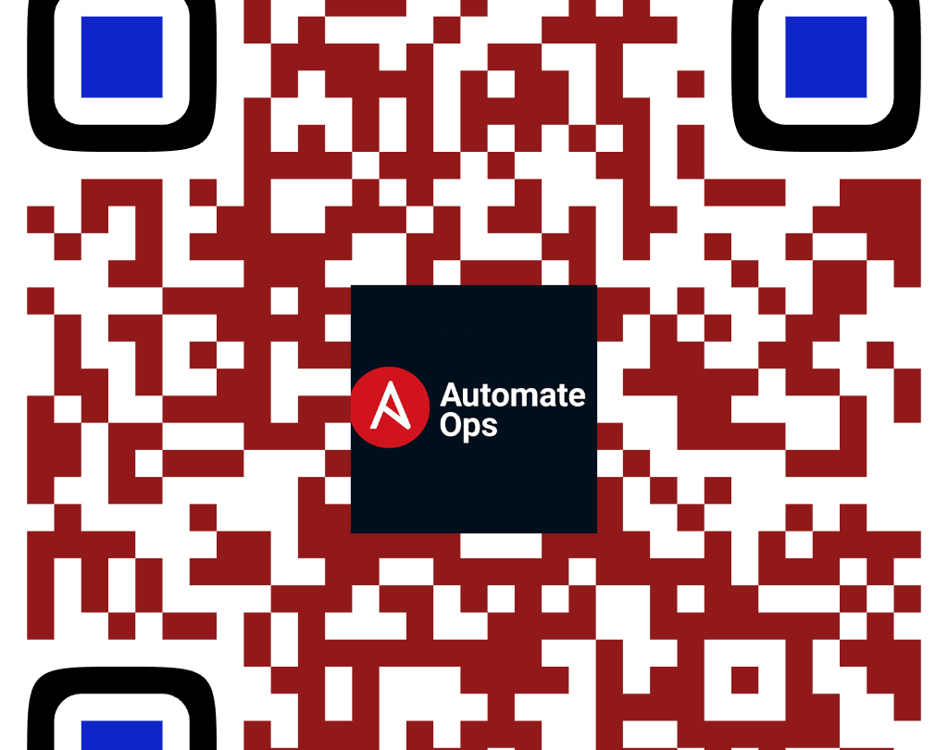
Like • Share • Comment
📢 Subscribe for more DevOps magic!
Scan to Subscribe
✔ Learn IT Automation with Ansible ✔ Like, Share & Subscribe for more DevOps content Follow us: YouTube: youtube.com/AutomateOps

Slide 14
Quick Demo

Slide 15

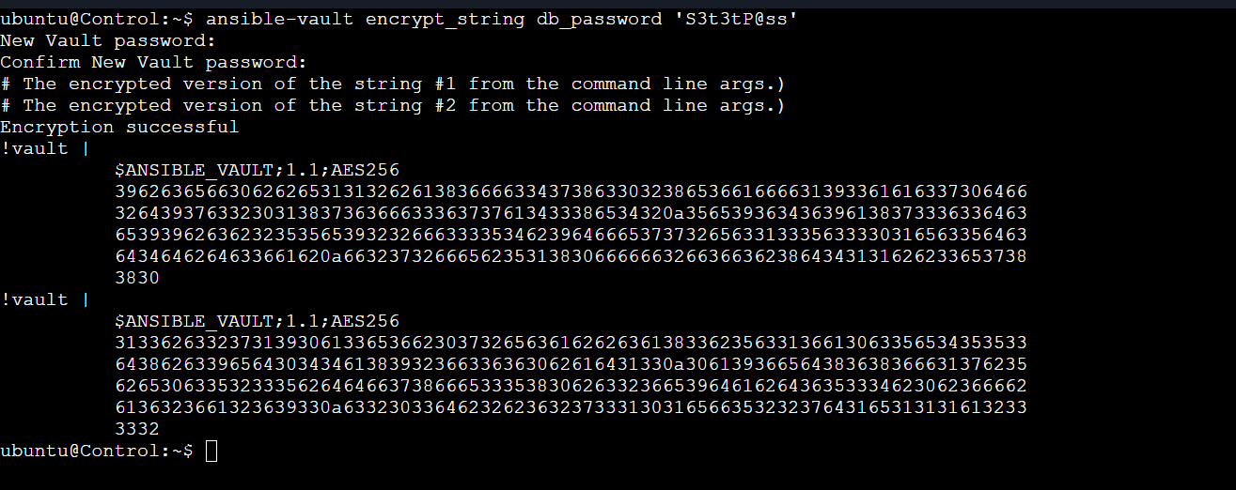
Demonstration
#1) Create an encrypted file
ansible-vault create group_vars/all.yaml
# 2) Encrypt a single variable for pasting
ansible-vault encrypt_string --name db_password 'S3cr3tP@ss'

Slide 16
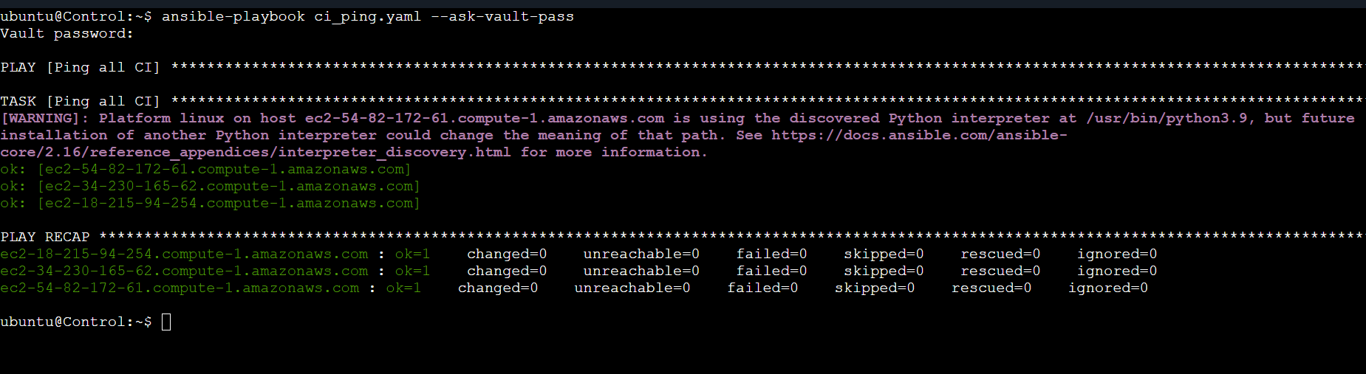
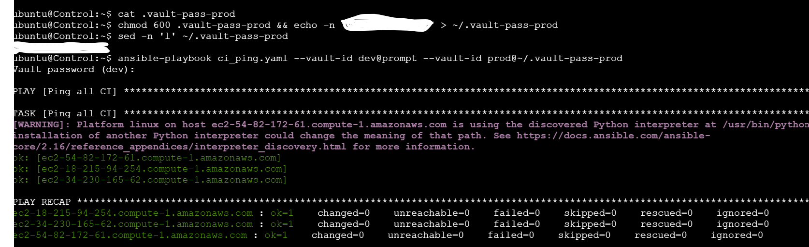
Demonstration
# 3) Run playbook with a prompt for the vault secret
ansible-playbook site.yml --ask-vault-pass
#4) Use Vault IDs per environment
Create ~/.vault-pass-prod : touch ~/.vault-pass-prod
Provide any password in the .vault-pass-prod:
chmod 600 .vault-pass-prod && echo -n <your-password> > ~/.vault-pass-prod
Verify the password using command
sed –n ‘l’ ~/.vault-pass-prod
Run:
ansible-playbook site.yml --vault-id dev@prompt --vault-id prod@~/.vault-pass-prod

Slide 17
Vault vs External Secret Managers
Use Ansible Vault for repo‑native encryption tightly coupled to inventory
Use external managers (HashiCorp Vault/Azure Key Vault/Secrets Manager) for dynamic secrets & centralized rotation
Hybrid: fetch at runtime and keep only bootstrap tokens in Ansible Vault
AutomateOps

Slide 18
Why Not Store Plaintext Secrets in Git?
📜 1. Permanent Git History Exposure
🕵️ Secrets remain recoverable forever
⛓ Every clone/fork keeps a copy
👥 2. Uncontrolled Access Spread
🚪 Ex‑employees, contractors, old clones
🌐 Accidental sharing across teams
🌍 3. Public Exposure Risks
⚠️ Mistakes during push/PR
🧲 Secrets scanned by bots on public repos
📑 4. Compliance Violations
🛡 SOC2, PCI, HIPAA, ISO non‑compliance
❌ Fails audits and security reviews
🛠️ 5. Tooling + Logs May Leak Secrets
🤖 CI/CD logs
🧰 IDE cache
📁 Shell history
🔄 6. No Secret Rotation Discipline
🔓 Visible secrets rarely get rotated
📉 Higher breach probability
Encrypt everything before committing to Git. Ansible Vault ensures AES‑256 encryption and secure runtime decryption

Slide 19
Like • Share • Comment
📢 Subscribe for more DevOps magic!
Scan to Subscribe
✔ Learn IT Automation with Ansible ✔ Like, Share & Subscribe for more DevOps content Follow us: YouTube: youtube.com/AutomateOps

